Slide 1


Foundations of Information Security
Core Frameworks, Threat Dynamics, Asset Defense & Case Analysis

Slide 2

01. The CIA Triad
The foundational framework governing information security controls and data protection.

Slide 3






The Three Pillars of Security
Confidentiality
Integrity
Availability
Restricting data access strictly to authorized entities. Enforced via strong encryption, multi-factor authentication (MFA), and role-based access control (RBAC).
Ensuring information remains authentic, accurate, and unalterable by unauthorized parties. Protected using cryptographic hashing, digital signatures, and audit logs.
Guaranteeing timely, reliable system and data access for authorized users. Maintained through redundant infrastructure, DDoS mitigation, and robust backups.

Slide 4


Threat, Vulnerability & Risk Dynamics
Threat vs. Vulnerability
Risk Formulation
Threat: Any circumstance or potential event with the capability to cause harm or exploit a system (e.g., Ransomware, Phishing, Rogue Insiders).
Risk Equation: Risk = Threat × Vulnerability × Impact
Risk represents the probability and magnitude of loss resulting from a threat successfully exploiting a system vulnerability. Mitigation involves lowering vulnerability or impact.
Vulnerability: A flaw or weakness in system design, implementation, or operational controls (e.g., Unpatched software, Missing MFA, Weak passwords).

Slide 5
Risk Assessment Matrix
Threat Scenario | Vulnerability Exploited | Risk Level | Impacted CIA Pillar
Unauthenticated Remote Login | Missing Multi-Factor Authentication (MFA) |  | Confidentiality & Availability
Spear-Phishing Credential Theft | Lack of Security Awareness Training |  | Confidentiality
SQL Injection Attack | Unsanitized Database Input Queries |  | Integrity & Confidentiality
Ransomware Encryption | Outdated Patching & Single Backup Copy |  | Availability & Integrity
Insider Data Exfiltration | Over-privileged User Permissions |  | Confidentiality

Slide 6
02. Defense & Incident Analysis
Safeguarding higher education assets and examining high-impact industry cyber breaches.

Slide 7



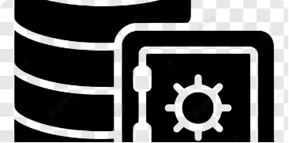
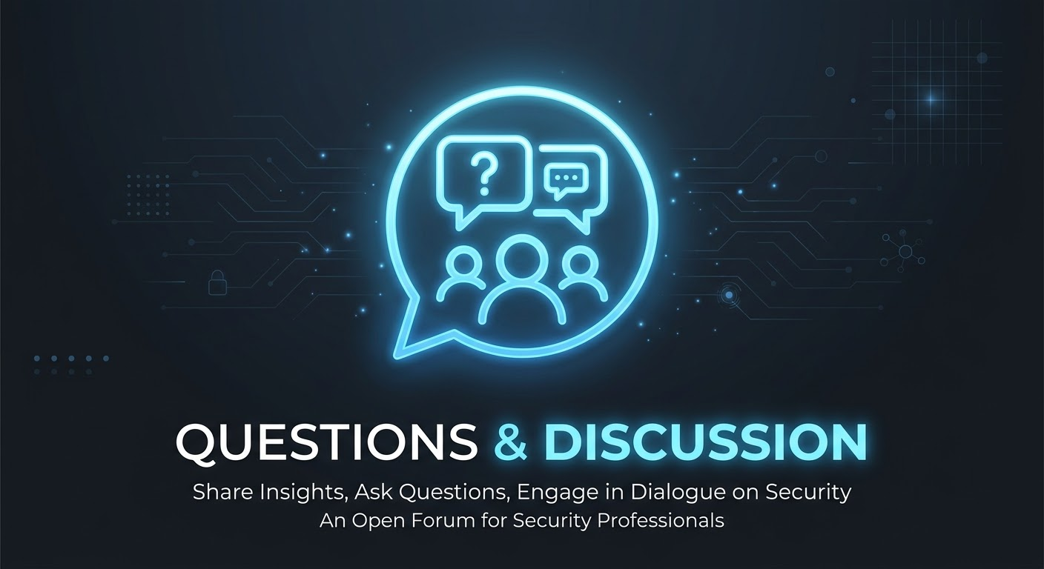

Academic Digital Asset Protection
Student Information Systems
Proprietary Research Data
Financial & HR Systems
Contains PII, grades, and financial records. High risk for identity theft and FERPA compliance violations.
Valuable intellectual property and grant research. Target for state-sponsored cyber espionage and data theft.
Controls payroll, vendor transactions, and operations. Primary target for ransomware extortion and wire fraud.

Slide 8
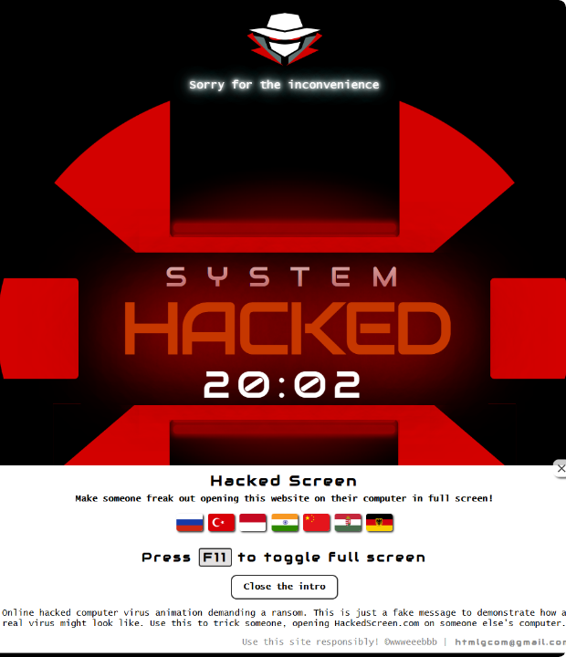
Case Analysis: Change Healthcare (2024)
Systemic National Failure
In February 2024, the BlackCat/ALPHV ransomware group breached Change Healthcare via stolen Citrix credentials on an unpatched remote portal.
Crucially, the legacy system lacked Multi-Factor Authentication (MFA), enabling threat actors to navigate undetected for 9 days prior to deploying data-wiping ransomware.

Slide 9



Quantifying the Healthcare Breach
192.7M
$2.45B
9 Days
Records Stolen
Total Cost Impact
Dwell Time
The largest healthcare data breach in US history, compromising personal health info.
Combined response costs, $22M ransom payment, and emergency provider advances.
Attackers spent nine days moving laterally before deploying ransomware encryption.

Slide 10
03. Ethics, Law & Governance
Navigating white-hat hacking boundaries, legal frameworks, and disclosure ethics.

Slide 11
Ethical Hacking & Legal Boundaries
Explicit Authorization Required: Penetration testing without written scope and explicit consent violates federal law (CFAA) regardless of intent.
Legal Frameworks (CFAA & GDPR): Cyber defenders must adhere to strict regulatory compliance standards, data privacy laws, and statutory breach reporting rules.
Coordinated Vulnerability Disclosure (CVD): Ethical hackers notify vendors privately and grant reasonable remediation periods before public release.

Slide 12
Questions & Discussion
Security is not a product—it is an ongoing operational process.

Slide 13






